Slide 1
Smart Factory Information Service Bus (SIBUS) for manufacturing application: requirement, architecture and implementation
Yoon, SooCheol, et al - Journal of Intelligent Manufacturing (2016): 1-20.
Seminário MO809 - 2º Semestre 2016

Slide 2
Sumário
PART I – Especificação do SIBUS
Introdução
Problemas
Requisitos
Arquitetura
Processo de Implementação
PART II – Caso de Estudo
Descrição
Implementação
Cenário de Uso
Comparação com outros middlewares
Considerações e Conclusões
Referências

Slide 3
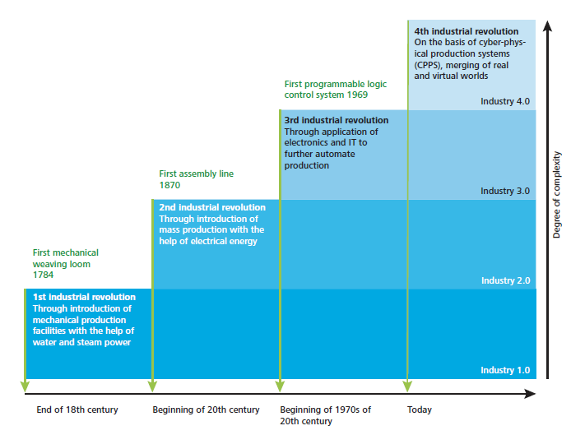
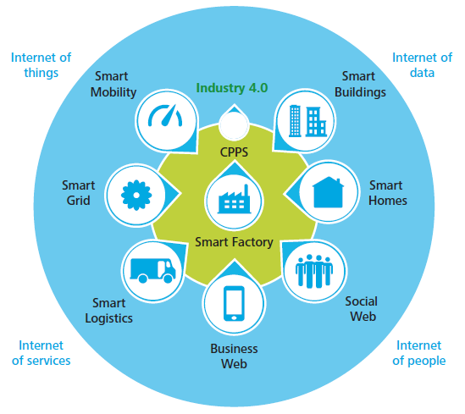
1. Introdução
Industry 4.0
Smart Factory refere-se a um ambiente baseado em IoT.
Fonte: [4] schaepfer15 – Industry 4.0 challenges and solutions for the digital transformation and use of exponential technologies

Slide 4
1. Introdução
Objetivo
Propor uma arquitetura de referência para o “barramento de informações” ou middleware para ser utilizado na aquisição de dados, análise e aplicações desde o nível das “máquinas” até o ERP.
Identificar problemas reais
Converter em requisitos
Definir a arquitetura
Estudo de caso de implementação

Slide 5
1. Introdução
Principais aspectos relativos à Smart Factory
Os componentes da Smart Factory estão conectados em rede e é possível coletar dados úteis dos mesmos;
O estado atual(corrente) dos componentes pode ser determinado e visualizado em tempo real;
Processos automáticos e autônomos podem ser executados baseados em planos de produção otimizados;
Serviços de produção avançados podem ser fornecidos no chão de fábrica e a sistemas externos.

Slide 6
1. Introdução
Objetivos do Smart Factory
Solução de Problemas como:
Ciclo de vida de produtos curto
Falta de experiência dos operadores
Regulamentação ambiental
Sistemas de manufatura isolados
Maior quantidade de requisitos dos clientes

Slide 7
1. Introdução
Objetivos do Smart Factory
Algumas soluções já foram aplicadas e solucionam alguns dos problemas:
Ubiquitous systems
Lean systems
Holonic systems
Porém os sistemas atuais necessitam de soluções mais abrangentes e com uso ativo de informações de todo processo produtivo:
Information and communication Technologies (ICT)
IoT
Big Data
Cloud computing

Slide 8
1. Introdução
Essência do Smart Factory
Como os dados são coletados,
Como os dados são analisados e
Como os dados são aplicados nos diversos sistemas dos diversos stakeholders.
Para se obter maior eficiência no fluxo de dados e informações é necessário um middleware especializado.
A proposta deste paper é definir um middleware que busca a melhoria do desempenho do processo de manufatura.

Slide 9
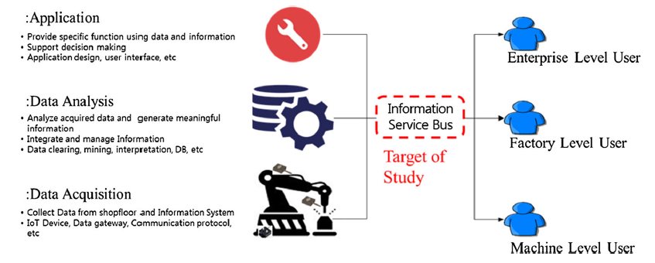
1. Introdução
Perspectiva de Informação no ambiente Smart Factory

Slide 10
1. Introdução
Algumas pesquisas prévias relativas a utilização de dados e tecnologia da informação abordaram:
Troca de informações de design, processo e recursos,
Processo de manufatura,
Monitoração,
Manutenção e
Reprocessamento e reciclagem.
Em um caso de uso de abrangência mais ampla, um sistema completo de Suporte aos Ciclo de Vida do Produto foi proposto (UPLS).

Slide 11
1. Introdução
Ubiquitous Produt Lifecycle Support (UPLS)
Middleware que suporta atividades relativas ao produto nas fases de:
Projeto,
Produção,
Uso e
Descarte
Utilizando informações em tempo-real relativas a cada fase.
Middleware orientado a produto!
Middleware não se mostra adequado no conceito de Smart Factory uma vez que o objetivo neste caso é uma melhoria de performance do ambiente como um todo, desde as máquinas, passando pela fábrica até a empresa.

Slide 12
1. Introdução
Ubiquitous Produt Lifecycle Support (UPLS)
Fonte: [2] lee09 – An architecture for ubiquitous product life cycle support system and its extension to machine tools with product data model.

Slide 13
1. Introdução
KPI(Key Performance Indicator) and TPI(Total Performance Indicator)
Estudos anteriores utilizaram, tipicamente, produtividade como KPI.
Considera-se que uma visão mais abrangente deve ser utilizada envolvendo questões ambientais e sustentabilidade as quais tem sido reforçadas nos ambientes de negócio e industrias. Assim várias KPIs devem ser consideradas.
ISO 22400 define KPIs para Gestão Operacional de Fabricação em diversas frentes como: tempo, logística e aspectos da qualidade como eficiência dos trabalhadores, taxa de transferência e taxa de qualidade.

Slide 14
1. Introdução
KPI(Key Performance Indicator) and TPI(Total Performance Indicator)
No estudo [3], foi proposto o conceito de TPI composto de indicadores de produtividade, ambientais e da sociedade que combinam efeitos relacionados ao produto, recursos, fabricação e humanos.
Neste paper, foi considerado da mesma forma o conceito de TPI com componentes derivados de impactos na produtividade, ambientais e na sociedade, não sendo utilizado foco em KPI específicas.
Fonte: [3] shin15 – Process-oriented Life Cycle Assessment framework for environmentally conscious manufacturing.

Slide 15
2. Problemas
Com o objetivo de se desenvolver um modelo realístico, é necessário que sejam considerados:
serviços disponíveis em sistemas reais de manufatura,
problemas reais a serem endereçados e
TPIs reais a serem avaliadas.
Os problemas foram levantados com base em projetos desenvolvidos na Korea e União Europeia entre 2010 e 2014.
Os problemas considerados são mais comuns em SMEs e podem não existir em grandes corporações.

Slide 16
2. Problemas

Slide 17
2. Problemas
[Problem (PR)#1] Collecting current-status data from the shop floor in real time is difficult. As a result, it takes time to identify problems.
[PR#2] Analysis of material consumption is conducted at factory level rather than machine level. This makes it difficult to know which machines or strategies are more efficient, and machine efficiency cannot be reflected in process planning and scheduling.
[PR#3] Performance evaluation is focused on only one or a few criteria (e.g., material removal rate and machining time). This can result in biased analysis from CTO defined policy.
[PR#4] Products and resources aremanually identified by workers. Manual identification can increase processing times with less reliability, and there remains the risk of errors due to human overload.

Slide 18
2. Problemas
[PR#5] Information systems work individually and are not networked to each other. There can be information gaps in processing operations with the potential for problems such as low quality, reworking, and overworking.
[PR#6] The production plan is scheduled without considering the current shopfloor environmental conditions. Temperature, humidity, or other environmental conditions can affect product quality. Without such considerations, quality cannot be guaranteed.
[PR#7]. It is difficult to predict the outcome of a manufacturing operation. There are gaps between the process plan and results in terms of product quality and production time, which eventually leads to lowermanufacturing efficiency.

Slide 19
2. Problemas
[PR#8] Shopfloor Information is mainly used for enterprise purposes rather than production purposes. There is no feedback to production planning and scheduling from such information, so manufacturing operations do not improve.
[PR#9] Manufacturing strategy is oriented more toward regular operations than exceptional cases. Machines or production lines cannot easily respond to varying conditions, delaying maintenance and operation times.
[PR#10] Decision making in shopfloor is dependent on worker’s knowledge. Knowledge differentials lead to unbalanced work assignment between workers, and novices have fewer opportunities to develop their skills.

Slide 20
3. Requisitos
Derivados 16 requisitos:
5 for Data Aquisition
4 for Data Analysis
7 on Application Provide

Slide 21
3. Requisitos
16 requirements
10 problemas
5 data aquisition
4 data analysis
7 application provide

Slide 22
3. Requisitos
Requirements for data acquisition
[RAq#1] Current factory status monitoring: it is necessary to monitor the current status of factories including man, machine, material and method which are known as the 4Ms of the factory. This consideration is essential for proactive and preventive activities in operations, as well as for process planning and scheduling. For this, it is necessary to have data acquisition and monitoring for workers, machines, products, and process data. (To Solve PR#1, #4, #6, #9, #10)
[RAq#2] Machine level material management: it is necessary to manage the material consumption of each machine. This capability is critical in process planning for improving environmental KPIs. It is necessary to measure the consumption of each material (e.g., electrical energy and coolant), and it should be possible to distinguish between states of themachine (i.e., idle, turning-on, ready, processing, and turning-off). (To solve PR#2, #3)

Slide 23
3. Requisitos
Requirements for data acquisition
[RAq#3] Independent and identical elements: it is necessary to manage the 4Ms in a smart factory identically, and they should be independent from certain processes or systems. With this consideration, context based services can be provided. For this, 4M element identification in various shopfloor situations is required (To solve PR #1, #4, #10)
[RAq#4] System interoperability: it is necessary to communicate with internal information systems including ERP, MES, CAD/CAM, product lifecycle management (PLM) and databases, as well as with external systems. Factory operations can be speeded up through interoperability. For this, it is necessary to have a unified 4M data model, database network, and common communication protocol. (To solve PR #3, #5, #8, #10)

Slide 24
3. Requisitos
Requirements for data acquisition
[RAq#5] IoT in factory: it is necessary to network all 4M elements in the factory. They should communicate with each other and with information systems so that the shopfloor and its information are synchronized in real time. For this, it is necessary to have agent and sensor technologies. (To solve PR #1, #5)

Slide 25
3. Requisitos
Requirements on data analysis
[RAn#1] Intelligent consumption analysis: it is necessary to analyze material consumption according to the information usage context. It should be analyzed under various conditions for evaluating and managing environmental performance, especially for energy consumption. For example, it should be possible to analyze the energy consumption of a single work center in producing a product or to compare the consumption of different machines. (To solve PR #2, #3)
[RAn#2] Verified process plan: it is necessary to verify the feasibility of a process plan at machine, factory, and enterprise levels. A verified process plan reduces the probability of operational risks such as failure, malfunction, or poor quality. For this, it is necessary to derive requirements and constraints of materials, machines, production line, workers, and existing plans and schedules from the process plan, as well as to check their availabilities. (To solve PR #6, #9)

Slide 26
3. Requisitos
Requirements on data analysis
[RAn#3] Intelligent performance evaluation: it is necessary to evaluate manufacturing performance from the perspective of productivity, environment and social impact. It should also be possible to predict the performance from the process plan and schedule. The current factory level can be determined and further goals defined through this capability. (To solve PR #3, #6, #7, #10)
[RAn#4] Traceable factory elements: it is necessary to trace the 4M factory elements. Here, traceability covers holistic characteristics of each element, not only physical location. With traceability, it is possible to make on-site decisions quickly. For this, it is necessary to ascertain the current status of each element (e.g., location, mode, failure, history, and further schedule). (To solve PR #1, #4, #6, #10)

Slide 27
3. Requisitos
Requirements on application provide
[RAp#1] Autonomous control: it is necessary to control manufacturing operations autonomously by the system itself. Since the manufacturing plan does not usually describe how to react to events, it is necessary to determine this for each of the 4Melements for better efficiency. For this, it is necessary to have ontologies and context reasoning technologies. (To solve PR #6, #8, #9)
[RAp#2] Field-based process plan: it is necessary to generate process plans and schedules considering actual shopfloor conditions. Process plans that assume ideal conditions can cause a series of operational problems. In order to avoid this, it is necessary for process planning to reflect realistic information such as availability, capacity, or constraints of manufacturing resources. (To solve PR #6)

Slide 28
3. Requisitos
Requirements on application provide
[RAp#3] Holistic performance management: It is necessary to build, evaluate, and manage performance of manufacturing processes from a holistic viewpoint. Holistic performance management clearly describes which points have to be improved, and it is possible to detect changes in performance quickly. For this, a performance model must be built and it should be possible to instance the model for evaluation and prediction. (To solve PR #6, #7, #8, #10)
[RAq#4] Networked information system: it is necessary to exchange information between various information systems. Data and information generated on the shopfloor can be used beneficially in other systems in the company, and are also useful for external stakeholders. (To solve PR #5, #8)

Slide 29
3. Requisitos
Requirements on application provide
[RAp#5] Modeling and simulation: it is necessary to model and run simulations for process plans. Through simulation it is possible to discover process plan defects. The best alternatives for process parameters can then be chosen without compromising performance. (To solve PR #3, #6, #7, #10)
[RAp#6] Real-time information treatment: it is necessary to treat the generated information in real-time. Manufacturing performance improves with faster response to events occurring during operation. This consideration is critical in rapid smart factory applications. (To solve PR #5, #8)

Slide 30
3. Requisitos
Requirements on application provide
[RAp#7] Manufacturing assistance: it is necessary to support workers in various situations. Expert knowledge is required in many manufacturing areas. However, not all workers are not equally skilled, so proper support is needed. Manufacturing assistance improves quality and reduces working time. For this, it is necessary to have knowledge libraries, cognitive, ontologies, and various support protocols. (To solve PR #8, #10)

Slide 31
4. Arquitetura
Smart factory service delivery elements

Slide 32
4. Arquitetura
Vision of SIBUS (Conceptual Model)

Slide 33
4. Arquitetura
Conceptual Aspects of SIBUS

Slide 34
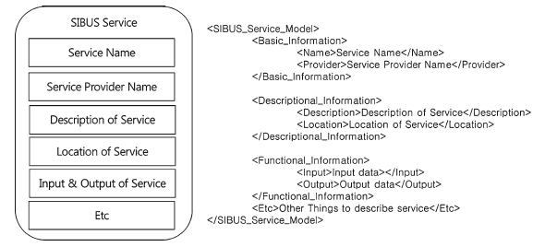
4. Arquitetura
SIBUS Service Description Language

Slide 35
4. Arquitetura
IDEF0 diagram for process application modules

Slide 36
4. Arquitetura
Reference architecture
of SIBUS

Slide 37
5. Processo de Implementação
Implementation Procedure

Slide 38
FIM – PARTE I

Slide 39
Revisão da Arquitetura SIBUS

Slide 40
6. Descrição
Target Product of Study: Fishhead

Slide 41
6. Descrição
Overall Operations of fishhead manufacturing

Slide 42
7. Implementação
SIBUS Implementation Procedure

Slide 43
7. Implementação
Goal and Scope Description

Slide 44
7. Implementação
AS-IS and TO-BE Factory Models

Slide 45
7. Implementação
AS-IS and TO-BE Information Flow

Slide 46
7. Implementação
SIBUS Architecture for study case

Slide 47
8. Cenário de Uso
Operation Scenario

Slide 48
9. Comparação com outros middlewares
Comparation
of
SIBUS

Slide 49
10. Considerações e Conclusões
.......

Slide 50
11. Referências
[1] yoon13 – Yoon, SooCheol, et al. "Smart Factory Information Service Bus (SIBUS) for manufacturing application: requirement, architecture and implementation." Journal of Intelligent Manufacturing (2016): 1-20
[2] lee09 – Lee, Byeong-Eon, and Suk-Hwan Suh. "An architecture for ubiquitous product life cycle support system and its extension to machine tools with product data model." The International Journal of Advanced Manufacturing Technology 42.5-6 (2009): 606-620.
[3] shin15 – Shin, Seung-Jun, et al. "Process-oriented Life Cycle Assessment framework for environmentally conscious manufacturing." Journal of Intelligent Manufacturing (2015): 1-19.
[4] schaepfer15 – Schlaepfer, R. C., and M. Koch. "Industry 4.0 challenges and solutions for the digital transformation and use of exponential technologies." Deloitte, AG, Zurich. http://​ www2.​ deloitte.​ com/​ content/​ dam/​ Deloitte/​ ch/​ Documents/​ manufacturing/​ ch-en-manufacturing-industry-4-0-24102014.​ pdf (20.12. 2015) (2015).

Slide 51
FIM
810043 – Amaury Mausbach Filho

